Slide 1


Internet Of Things
Presented By: mohadeseh Tabatabaei nia
Professor: Dr. Zahra Asaei

Slide 2

Table of Content:
Definition of IOT
History of IOT
Benefits
Examples
Challenges
Future
Resources
2

Slide 3
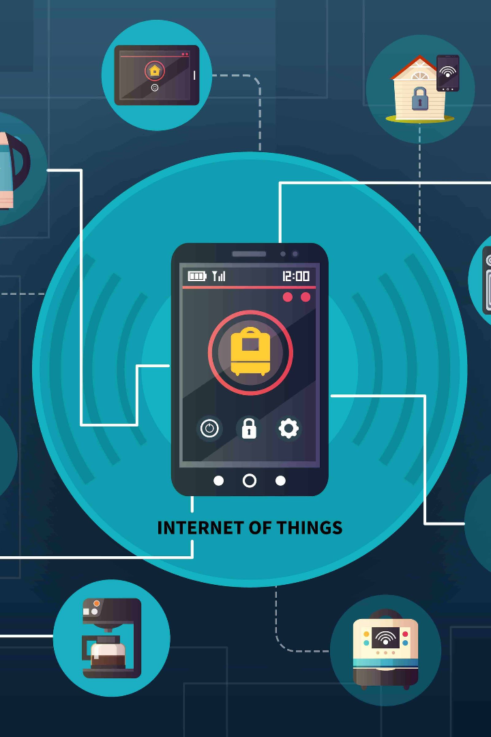
Internet of Things
The Internet of Things (IoT) refers to the network of objects connected to the internet, allowing them to send and receive data. It is revolutionizing how we interact with technology.

Slide 4
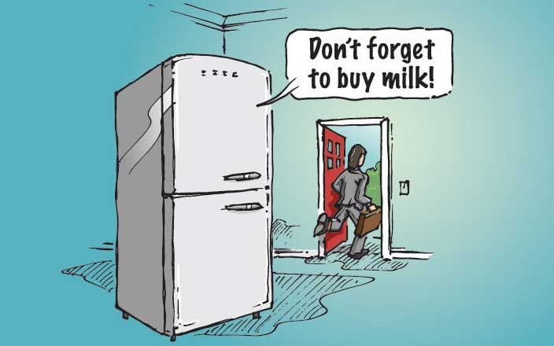
I
Smart Fridge
4

Slide 5
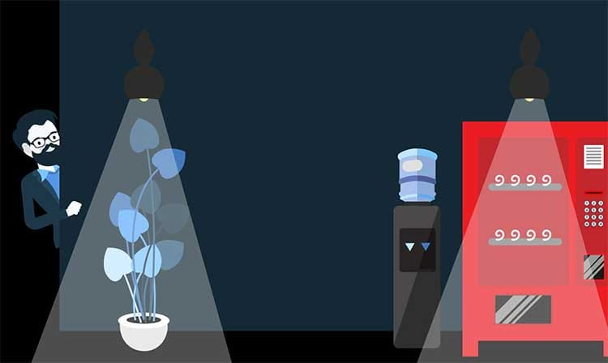
I
First IOT Device
5

Slide 6
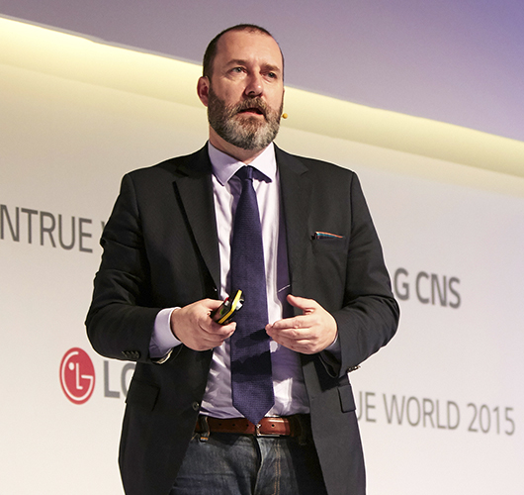
I
Kevin Ashton
The term 'Internet of Things' was coined in 1999 by the computer scientist Kevin Ashton.
6

Slide 7
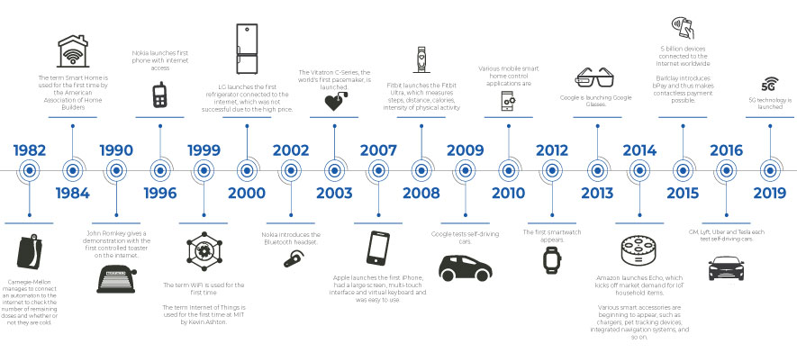
History of IoT

Slide 8
Key Components of IOT
1
Sensors
2
Connectivity
Devices that collect data from the physical environment, such as temperature, humidity, and motion.
Allows objects to connect to the internet and communicate with each other through various technologies such as Wi-Fi and Bluetooth.
3
Cloud Computing
4
Data Processing
Provides storage and processing power for IoT devices, allowing for real-time data analysis and remote control.
The collected data is processed and analyzed to derive meaningful insights and enable intelligent decision-making.
8

Slide 9
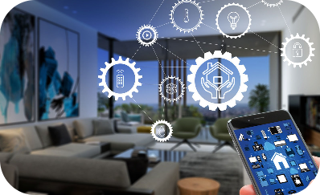
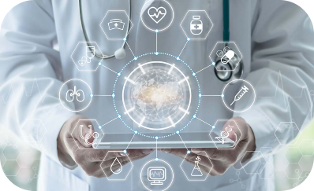
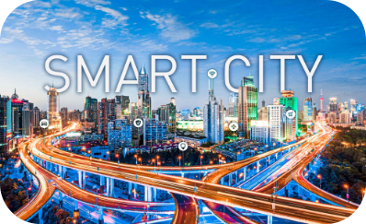
Examples of IOT Applications
Smart Homes
Healthcare
Smart Cities
Connected devices that remotely control and monitor home appliances, lighting, security systems, and more.
IoT-enabled medical devices and wearable sensors for remote patient monitoring and efficient healthcare management.
Intelligent infrastructure and services for energy management, transportation, waste management, and public safety.
9

Slide 10
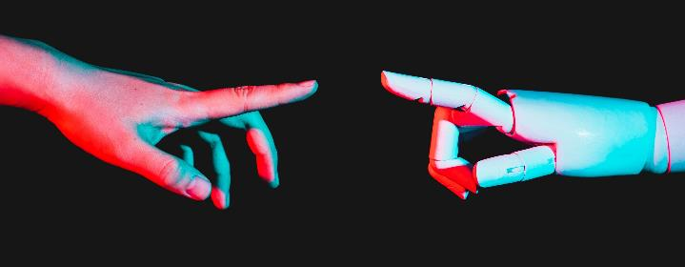
Challenges of IOT:
Security
Protecting IoT devices and networks from cyber threats and ensuring data privacy.
Privacy
The need for different IoT devices, platforms, and protocols to work seamlessly
together.
Reliability
Reliability refers to the ability of a system to perform its intended function consistently and without failure over time.
10

Slide 11
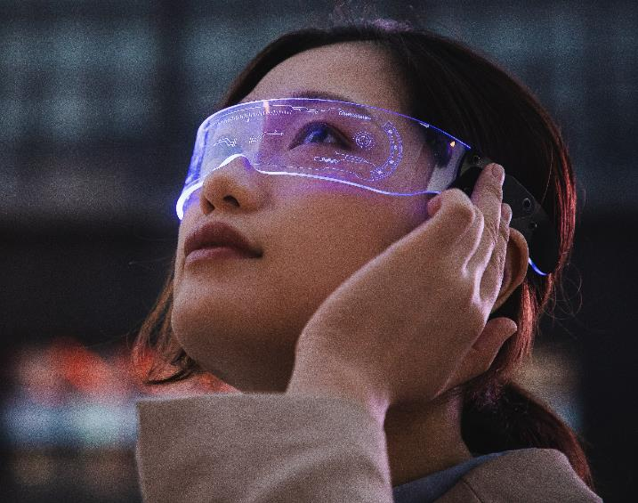
I
Future Of
IoT
11

Slide 12

Resources
https://www.geeksforgeeks.org/
https://www.visionofhumanity.org/
https://www.knowledgehut.com/blog/web-development/iot-future
https://www.dataversity.net/brief-history-internet-things/
https://www.techtarget.com/iotagenda/definition/Internet-of-Things-IoT
12

Slide 13
Thank You!
By: mohadeseh Tabatabaei nia

